Slide 1
Chapter 2 Bayesian Computation
Dr. Nilesh Patil

Slide 2
Introduction
In this chapter, several strategies for computing and summarizing posterior distributions are discussed.
One basic strategy is to find the posterior mode and then approximate the density with a “matching” normal density.
A second strategy is to devise an algorithm for simulating directing from the posterior distribution.
We describe the use of a popular simulation algorithm, rejection sampling, to implement this sampling.
Importance sampling and sampling importance resampling (SIR) algorithms are alternative general methods for computing integrals and simulating from a general posterior distribution.

Slide 3

Computing Integrals
The goal here is simply to point out that everything you want to compute in Bayesian calculations is an integral.
If we observe data y from a sampling density f(y|θ), where θ is a vector of parameters and one assigns θ a prior g(θ), then the posterior density of θ is proportional to g(θ|y) ∝ g(θ)f(y|θ).
The computational problem is to summarize this multivariate probability distribution to perform inference about functions of θ.
Many of the posterior summaries are expressible in terms of integrals.
Suppose we are interested in the posterior mean of a function h(θ). This mean is expressible as a ratio of integrals

Slide 4


Computing Integrals
If we are interested in the posterior probability that h(θ) falls in a set A, we wish to compute
Integrals are also involved when we are interested in obtaining marginal densities of parameters of interest.
Suppose we have the parameter θ = (θ1, θ2), where θ1 are the parameters of interest and θ2 are so-called nuisance parameters.
One obtains the marginal posterior density of θ1 by integrating out the nuisance parameters from the joint posterior:
In the common situation where one needs to evaluate these integrals numerically, there are a number of quadrature methods available. However, these quadrature methods have limited use for Bayesian integration problems.
First, the choice of quadrature method depends on the location and shape of the posterior distribution.
Second, for a typical quadrature method, the number of evaluations of the posterior density grows exponentially as a function of the number of components of θ.

Slide 5
A Beta-Binomial Model for Overdispersion
Single parameter distributions, such as Poisson and Binomial, imply that the variance is determined by the mean.
However, in many cases and especially in analysis of biological data, this mean-variance relationship fails mainly due to presence of overdispersion, where the data have a higher variance than anticipated under the simple model
A Beta-Binomial model is a statistical model used to describe overdispersion in count data.
It's often used when the variance of observed counts is greater than what would be expected under a simple binomial model.
In this model, the binomial probability parameter follows a beta distribution, which allows for extra variability.
In this context, "overdispersion" refers to the phenomenon where the observed data shows more variation than expected based on a simple binomial model.
The Beta-Binomial model is a way to account for this extra variability by introducing additional parameters that describe the distribution of the binomial probabilities.
This model is particularly useful in various fields, including epidemiology, biology, and social sciences, where count data is common, and overdispersion is often observed.
It allows for a more flexible and realistic representation of the data.

Slide 6
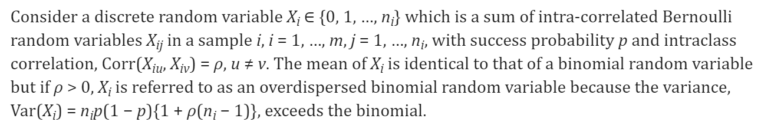
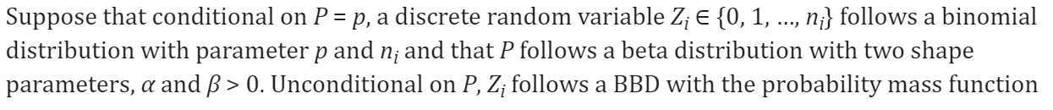
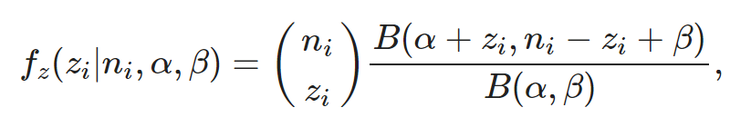
Parameter Setup in Beta Binomial
where B(α, β) is a beta function. The mean and variance of Z_{i} are
where μ = α/(α + β) and ϕ = 1/(α + β + 1).

Slide 7
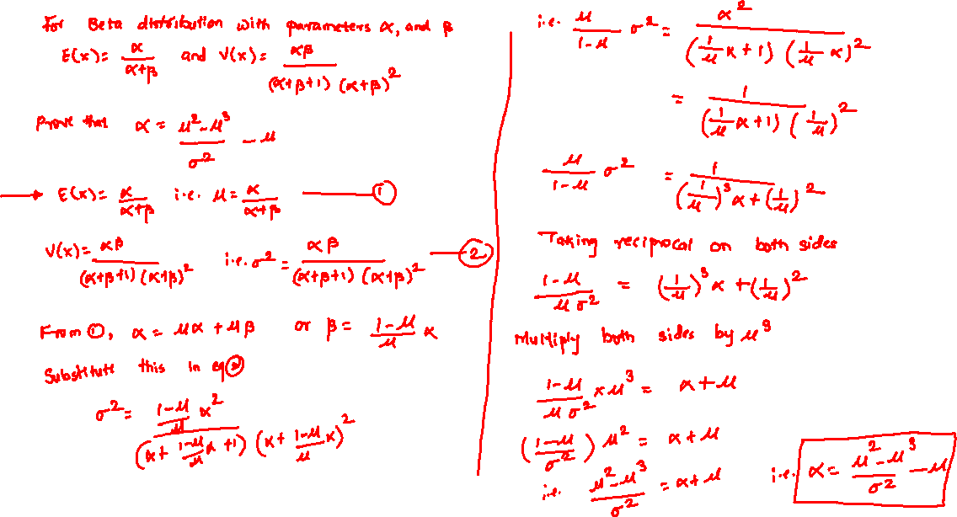

Slide 8
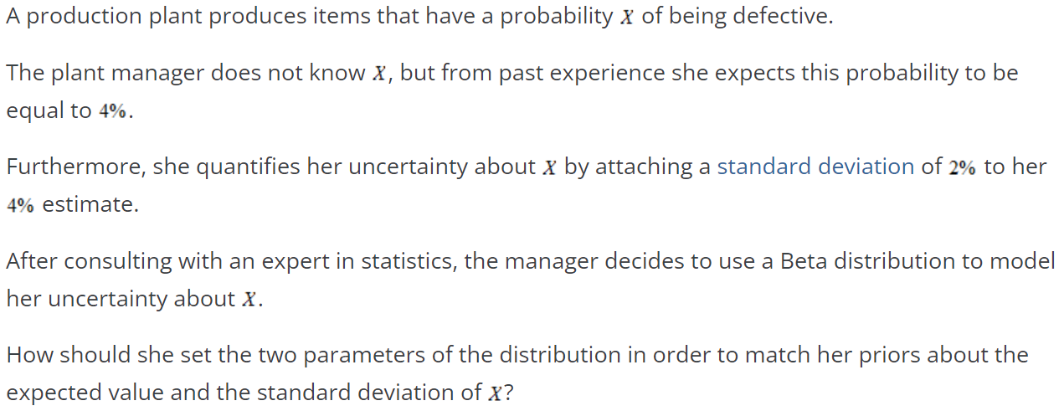
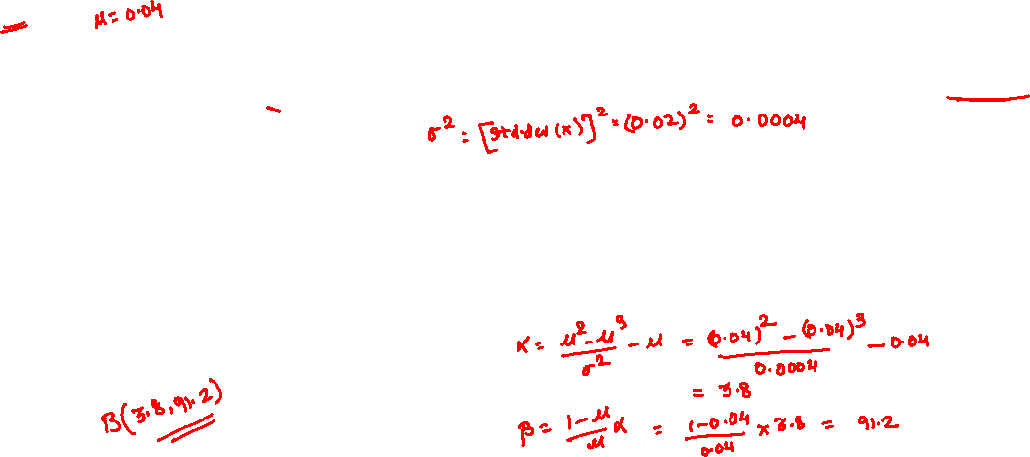
Example 1:

Slide 9

Example 2
After choosing the parameters of the Beta distribution so as to represent her priors about the probability of producing a defective item (see previous exercise), the plant manager now wants to update her priors by observing new data.
She decides to inspect a production lot of 100 items, and she finds that 3 of the items in the lot are defective.
How should she change the parameters of the Beta distribution in order to take this new information into account?
Example 3
After updating the parameters of the Beta distribution (see previous exercise), the plant manager wants to compute again the expected value and the standard deviation of the probability of finding a defective item.
Can you help her?

Slide 10
Monte Carlo Integration
Monte Carlo methods are based on the use of random numbers and probability statistics to investigate problems.
In mathematics, Monte Carlo integration is a technique for numerical integration using random numbers. It is a particular Monte Carlo method that numerically computes a definite integral.
Essentially, the Monte Carlo method solves a problem by directly simulating the underlying (physical) process and then calculating the (average) result of the process.
Because of their reliance on repeated computation of random or “pseudo-random” numbers, these methods are most suited to calculation by a computer.

Slide 11
Steps in Monte Carlo Integration
Define a Domain of Possible inputs
Generate Inputs randomly from the domain using a certain specified probability distribution
Perform a deterministic computation ( this means that given a particular input it will always produce the same output ) using inputs
Aggregate the results of the individual computations into a final result

Slide 12
Why Use the Monte Carlo Method?
Handling complex probability distributions: Bayesian models often involve high-dimensional probability distributions that are difficult or impossible to integrate analytically. Monte Carlo methods allow us to approximate these integrals numerically.
Posterior sampling: Monte Carlo techniques, especially Markov Chain Monte Carlo (MCMC) methods, enable sampling from complex posterior distributions. This is crucial for estimating parameters and making inferences in Bayesian models.
Flexibility: Monte Carlo methods can handle a wide variety of probability distributions and model structures, making them versatile for different Bayesian problems.
Scalability: While computationally intensive, Monte Carlo methods can be parallelized and scaled to handle large datasets and complex models.
Uncertainty quantification: By generating samples from the posterior distribution, Monte Carlo methods provide a natural way to quantify uncertainty in Bayesian estimates.
Handling intractable likelihoods: In some cases, the likelihood function may be difficult to compute directly. Approximate Bayesian Computation (ABC) methods, which use Monte Carlo techniques, can be used in such scenarios.
Model comparison: Monte Carlo methods can be used to estimate marginal likelihoods, which are important for Bayesian model comparison and selection.

Slide 13

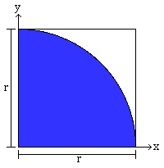
Monte Carlo Calculation of Pi
We will use the unit circle circumscribed by a square.
However, it is easier to just use one quadrant of the circle.
So lets pretend you are a horrible dart player.
Every throw is completely random.
Now, imagine throwing darts at the unit circle
Because your throws are completely random,
the number of darts that land within the shaded unit circle is proportional to the area of the circle
In other words, =

Slide 14
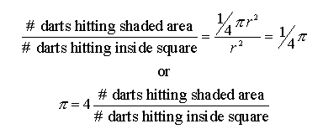
Monte Carlo Calculation of Pi
If you remember your geometry, it is easy to show:
If each dart thrown lands somewhere inside the square, the ratio of "hits" (in the shaded area) to "throws" will be one-fourth the value of pi.

Slide 15
Monte Carlo Calculation of Pi
If you actually tried this experiment, you would soon realize that it takes a very large number of throws to get a decent value of pi...well over 1,000.
To make things easy on ourselves, we can have computers generate random numbers.
If we say our circle's radius is 1.0, for each throw we can generate two random numbers, an x and a y coordinate
we can then use (x,y) to calculate the distance from the origin (0,0) using the Pythagorean theorem.
If the distance from the origin is less than or equal to 1.0, it is within the shaded area and counts as a hit.
Do this thousands (or millions) of times then average, and you will wind up with an estimate of the value of pi. How good it is depends on how many iterations (throws) are done.

Slide 16
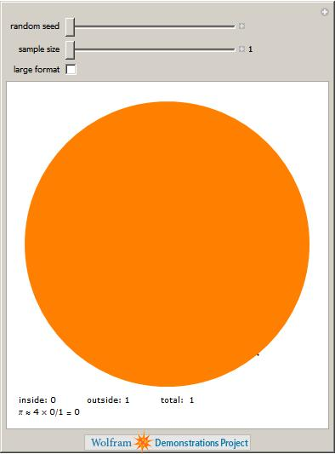
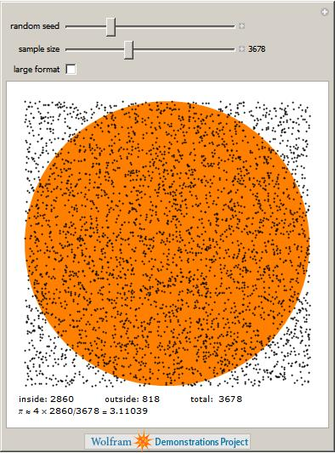
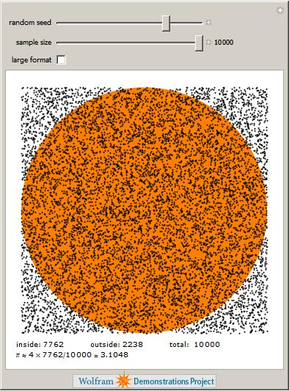
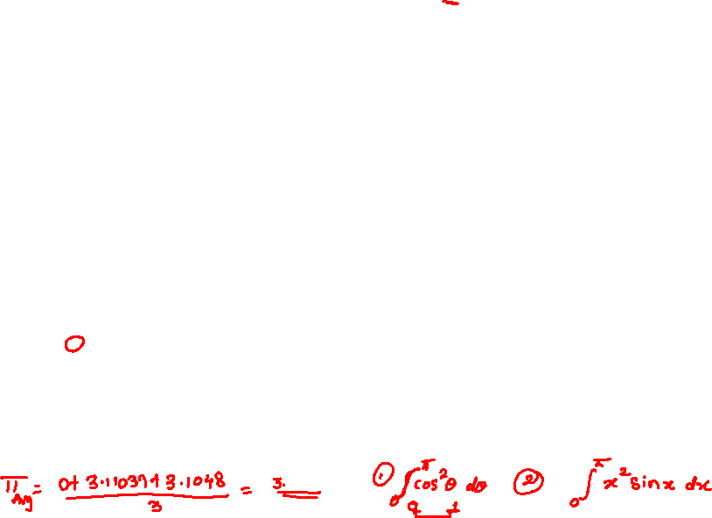

Slide 17
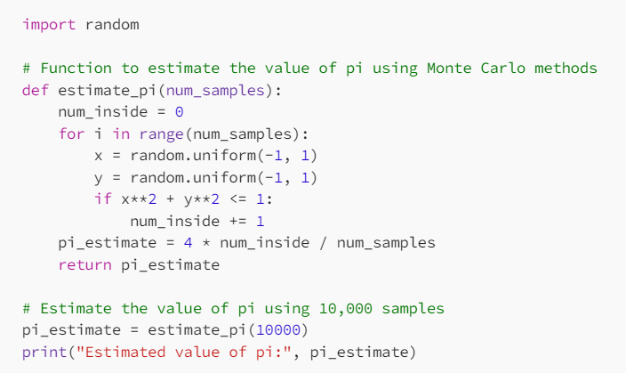
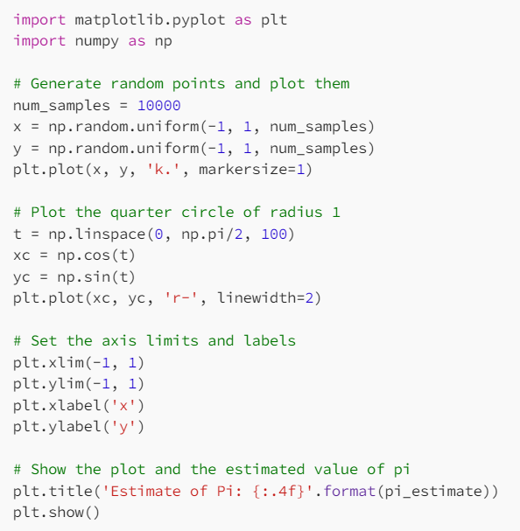

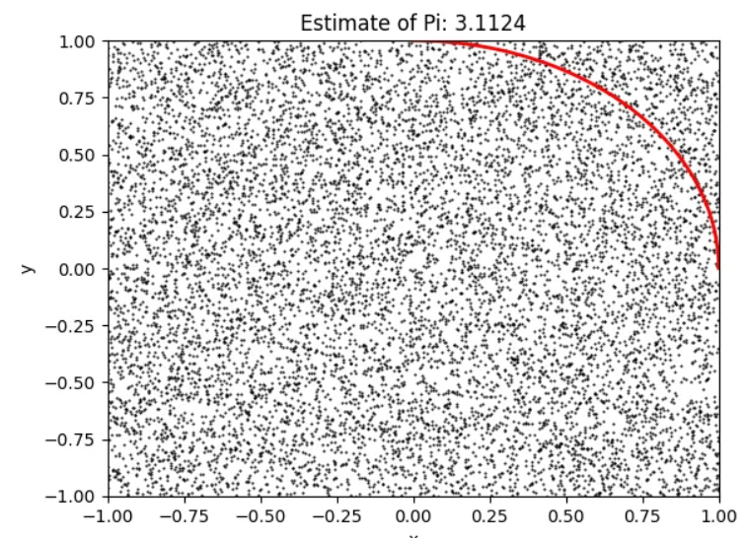
Python Code for Estimation of Pi

Slide 18
Rejection Sampling
Rejection sampling is a method used to generate samples from a target distribution p(x) that might be difficult to sample from directly. It uses a proposal distribution q(x) that is easier to sample from, along with an acceptance/rejection step.
Process:
Choose a proposal distribution q(x) that envelopes p(x) when scaled by a constant M.
Generate a sample x from q(x).
Generate a uniform random number u between 0 and 1.
Accept x if u <= p(x) / (M * q(x)), otherwise reject it.
Repeat until the desired number of samples is obtained.

Slide 19
Use of Rejection Sampling in Bayesian Computing
In Bayesian inference, we often need to sample from posterior distributions that don't have closed-form solutions.
Rejection sampling can be used to generate these samples, which can then be used for parameter estimation, model comparison, or predictive inference.

Slide 20
Advantages of Rejection Sampling
Conceptually simple
Generates independent samples
Samples are exactly from the target distribution

Slide 21
Disadvantages of Rejection Sampling
Can be inefficient, especially in high dimensions or when the proposal doesn't closely match the target.
Requires knowing a bound M, which can be challenging to determine.

Slide 22
Importance Sampling
Importance sampling is a technique used to estimate properties of a target distribution p(x) by using samples from a different, easier-to-sample proposal distribution q(x). It's particularly useful when p(x) is difficult to sample from directly.
Process:
Choose a proposal distribution q(x) that is easy to sample from and has support wherever p(x) does.
Generate samples from q(x).
Assign importance weights w(x) = p(x) / q(x) to each sample.
Use these weighted samples to estimate properties of p(x).

Slide 23
Use of Importance Sampling in Bayesian Computing
In Bayesian inference, importance sampling is often used to:
Estimate expectations under the posterior distribution
Compute marginal likelihoods (for model comparison)
Approximate intractable integrals in high-dimensional spaces

Slide 24
Advantages
Can be more efficient than rejection sampling, especially in high dimensions
Doesn't require knowing an upper bound on the target density
Can provide unbiased estimates of expectations

Slide 25
Disadvantages
Performance depends heavily on the choice of proposal distribution
Can be inefficient if the proposal distribution is very different from the target
May suffer from high variance in the estimates if some weights are much larger than others

Slide 26
Sampling Importance Resampling (SIR)
Sampling Importance Resampling (SIR) is a method that combines importance sampling with a resampling step. It aims to generate samples that are approximately distributed according to the target distribution, even when the proposal distribution is not a close match.
Process:
Generate a large number of samples from a proposal distribution q(x).
Calculate importance weights w(x) = p(x) / q(x) for each sample.
Normalize the weights.
Resample with replacement from the weighted samples to obtain unweighted samples approximately distributed according to p(x).

Slide 27
Use of SIR in Bayesian Computing
In Bayesian inference, SIR is used to:
Generate samples from complex posterior distributions
Improve upon simple importance sampling when the proposal and target distributions are very different
Serve as a component in more advanced algorithms like particle filters

Slide 28
Advantages of SIR
Can produce unweighted samples from the target distribution
Often more robust than simple importance sampling when the proposal is a poor match for the target
Can be more efficient than rejection sampling in high dimensions

Slide 29
Disadvantages of SIR
Introduces additional Monte Carlo error due to the resampling step
Can suffer from sample impoverishment if the effective sample size is low
Still relies on a reasonable proposal distribution for good performance

Slide 30
Comparison of Rejection Sampling, Importance Sampling and SIR
Aspect | Rejection Sampling | Importance Sampling | Sampling Importance Resampling (SIR)
Basic Principle | Generate samples from proposal distribution and accept/reject based on target/proposal ratio | Generate weighted samples from proposal distribution | Generate weighted samples, then resample based on weights
Output | Unweighted samples from target distribution | Weighted samples | Unweighted samples approximating target distribution
Efficiency | Can be inefficient, especially in high dimensions | Generally more efficient than rejection sampling | Often more efficient than rejection sampling, can be more robust than importance sampling
Proposal Requirements | Proposal must envelope target when scaled (M * q(x) ≥ p(x)) | Proposal must have support wherever target does | Same as importance sampling
Sensitivity to Proposal Choice | Highly sensitive | Sensitive | Less sensitive than importance sampling
Scalability to High Dimensions | Poor | Moderate | Moderate to Good
Handling Complex Targets | Struggles with complex, multimodal targets | Can handle complex targets, but efficiency depends on proposal | Can handle complex targets, with some robustness to poor proposals
Implementation Complexity | Simple | Moderate | Moderate to Complex
Key Advantage | Generates exact samples from target | Can estimate expectations efficiently | Produces unweighted samples approximating target
Key Disadvantage | Can be very inefficient | High variance if proposal is poor match | Introduces extra Monte Carlo error in resampling step
Diagnostics | Acceptance rate | Effective Sample Size (ESS) | ESS for importance sampling step
Use Cases | Simple low-dimensional problems | Estimation of expectations, marginal likelihoods | Sequential problems, particle filtering
Variants/Extensions | Adaptive rejection sampling | Annealed importance sampling | Particle filtering, Sequential Monte Carlo

